Slide 1
TLM Development
Meeting #7
August 14, 2012
T. Leveling
8/14/2012

Slide 2
TLM Development History

Slide 3
TLMs History at Pbar/Muon (1 of 3)
5/4/2011 - Director’s review for mu2e
6/16 - first TLM meeting
6/29 - first 2 TLMs installed with 6 decade rate BLM cards
7/14 - first TLM signal
7/19 – second meeting
7/19 – first BLM integration cards installed
8/18 - Chipmunk digitizer circuit installed (Blue box)
8/25 – third meeting
8/26 - Installed 16 bit VME scalar for higher counting rate from blue box (1 kHz)
9/1 - Installed third TLM of different length 103 m (338’)
9/2 - Standardized ACNET TLM responses on all electrometers to nC
9/13 – changed to 32 bit VME scalar
10/6 – Tried to pressurize TLMs – 6 psig 0.1 lpm
10/11 – reverted to unpressurized TLMs – 0.05 lpm
10/14 - Meeting with ES&H Section to get turnover for blue box construction
10/18 – Strategy for setting trip levels becomes apparent
10/26 – installed 1’ TLM at A2B7
10/31 – begin plateau measurements – suggested by ES&H section
10/31 – Established remote operation of TLM HV supply
11/18 – sequencer driven data collection for plateaus established
11-21 – low and medium intensity plateaus completed
11/23 – TOR910 rescaled for high intensity
12/8 – Marv provides 6517B electrometer for high intensity plateaus – suggested by ES&H section
12/8 – ES&H Section requests charge collection time measurement (TLMS on scope terminated in to 50 Ω)
12/15 – 4th meeting

Slide 4
TLMs History at Pbar/Muon (2 of 3)
12/21 – Started data collection for high intensity plateaus with 6517B
1/3/12 – nonlinear response of TLMs at high intensity becomes a concern
1/5/12 – observed HV sag for high intensity pulses
1/5- measured TLM response with scope terminated into 50 ohms
1/6- added in line capacitance to HV supply to reduce HV sag
1/9- Started making measurements with 6517B in voltage mode using capacitor voltage divider circuit
2/1 – Finished draft of TLM dynamic range requirements document
2/3 – General TLM requirements drafted (P. Czarapata)
2/10 – 5th meeting
2/14/12 – TLM web page created
4/11 to 4/19 - Collected TLM response data for 1’, 10’, 125’, 250’ TLM at three intensities (2 decade range)
7/18 – 6th meeting
2/14/12 - Created TLM web page

Slide 5
TLMs History at Pbar/Muon (3 of 3)
4/11/12 to 4/19/12
Repositioned 125’ TLM to make measurement at A2B7
Built & installed 10’ TLM
Installed 1’ TLM
Completed plateaus for 10’, 125’, and 250’ TLMs
three intensities plateaus
With the beam loss at A2B7
Compare with 338’ high intensity response
Completed 1’ TLM plateau for middle intensity
Determined TLM detector end effects are not significant
6/12 - Developed plan for making TLMs leak-tight for detector gas (mu2e conceptual design)

Slide 6
Work completed since July meeting

Slide 7
Concurrence that scaling described in dynamic range requirement document is correct (Sam)
Produced a note on TLM background observations (Tony)
New parts for next generation TLM (Gianni)
Obtained quote for heartbeat resistor (Dan)
Ordered resistor for heartbeat (Dave)
Retrieved 10’ TLM to prepare for installation at LINAC (Dave/Tony)
Gas leak tight
Sealed inner conductor (no gas flow in center conductor)
Terminations at DS end for heartbeat resistor

Slide 8
RESULTS

Slide 9
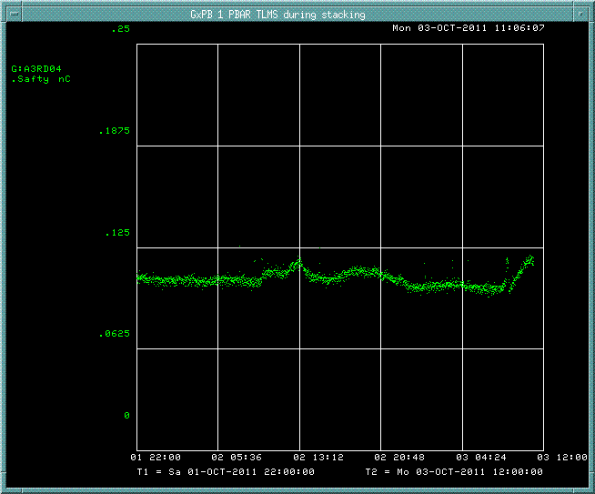
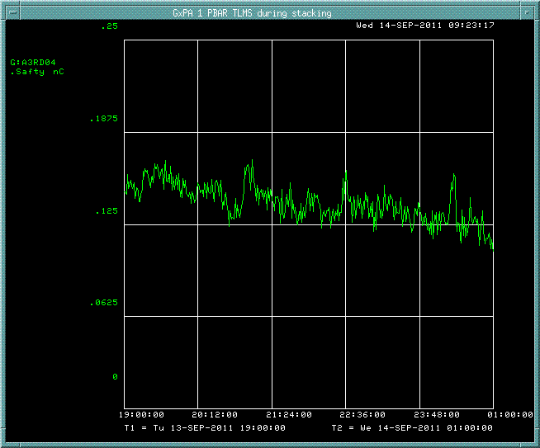
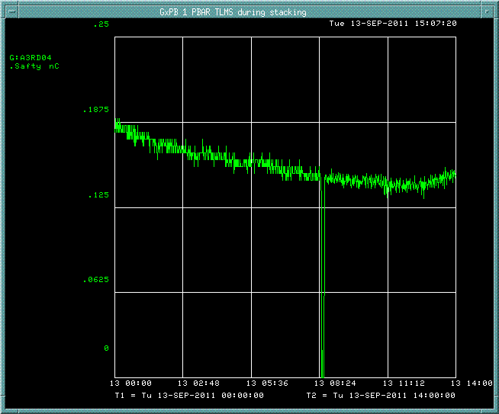
Background with no beam over period of hours
125’
338’
250’

Slide 10
Average 1.38 nC/minute

Slide 12
Target heartbeat background
No beam background

Slide 14
Electrometer Development
ES&H files are on TLM work page
Project board obtained (Marv)
Need another one?
Blue box on loan from ES&H Section
First job is to produce a new digitizer circuit
Discussion . . .

Slide 15
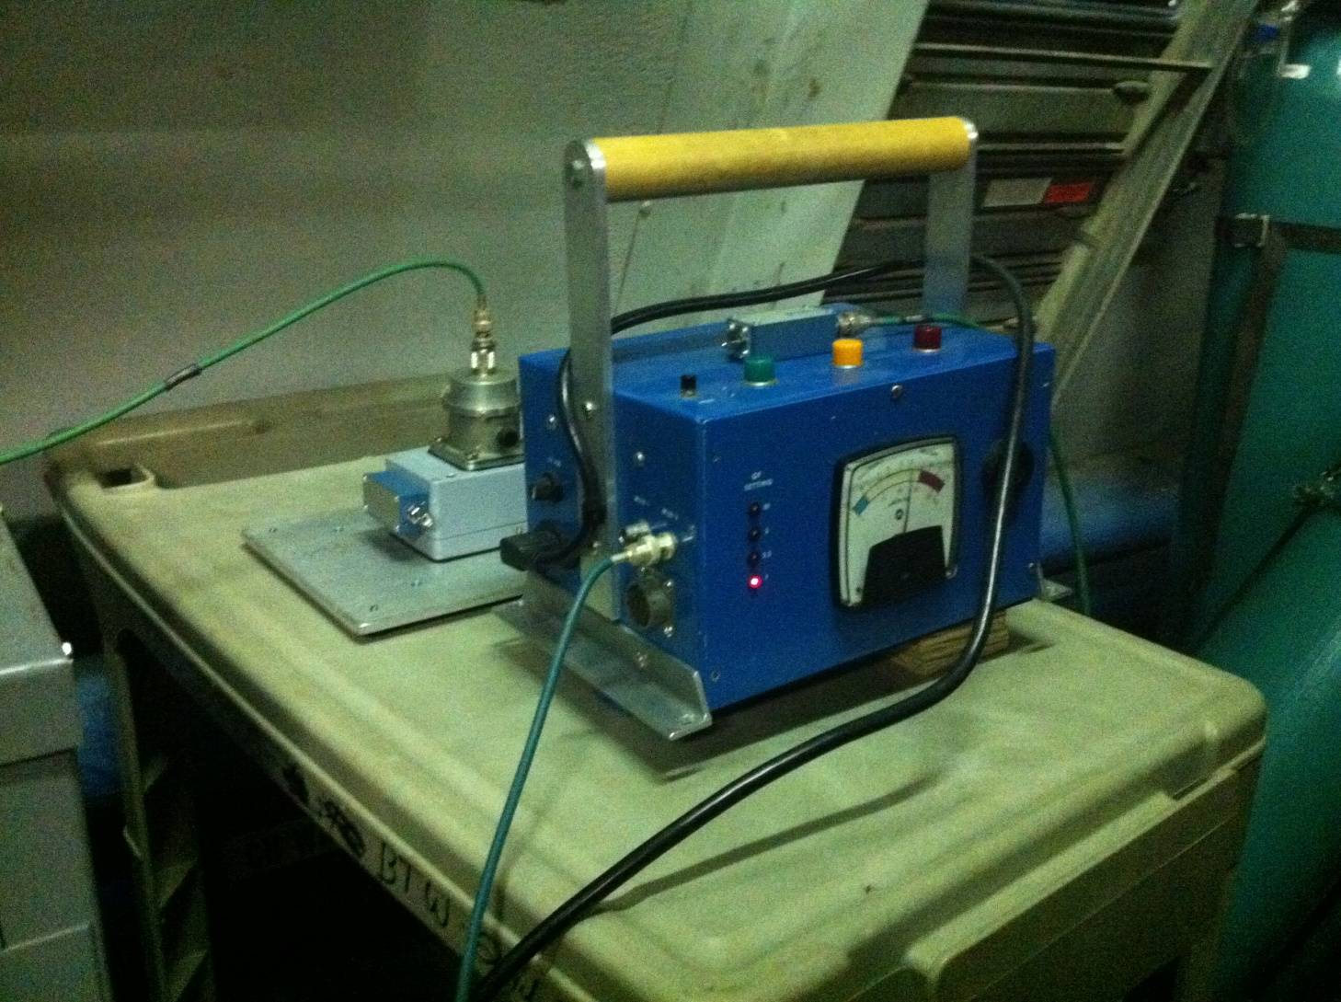
Digitizer circuit

Slide 16
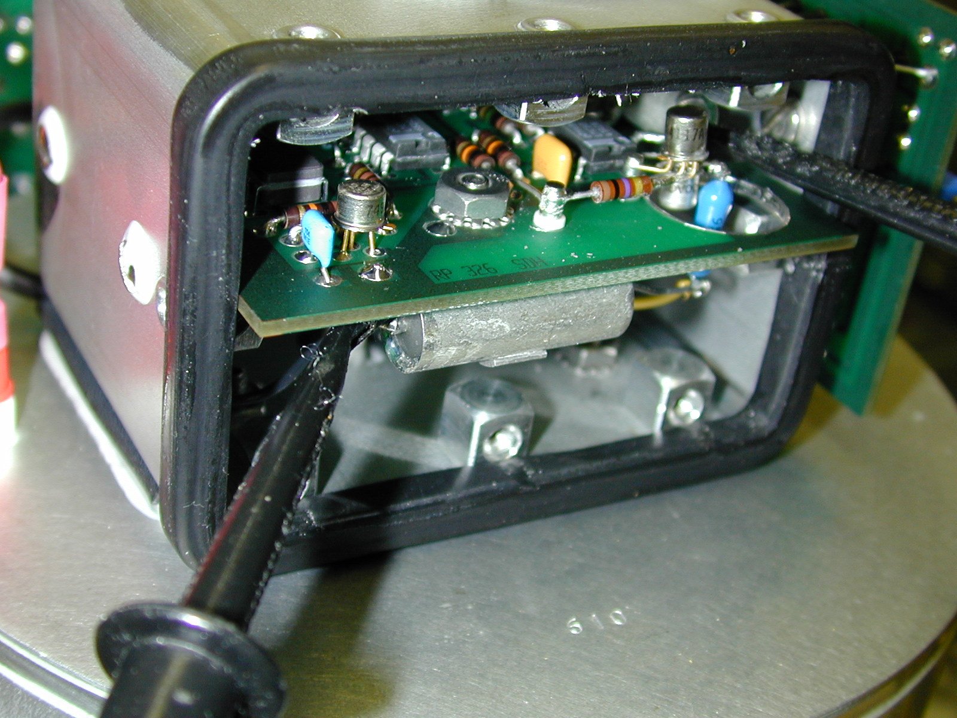

Slide 17
Digitizer circuit
Suppose 5 uC/minute is a reasonable upper control limit
Rad card input upper limit
10 kHz (?)
Then digitizer charge per output pulse

Slide 18
Backup slides

Slide 19
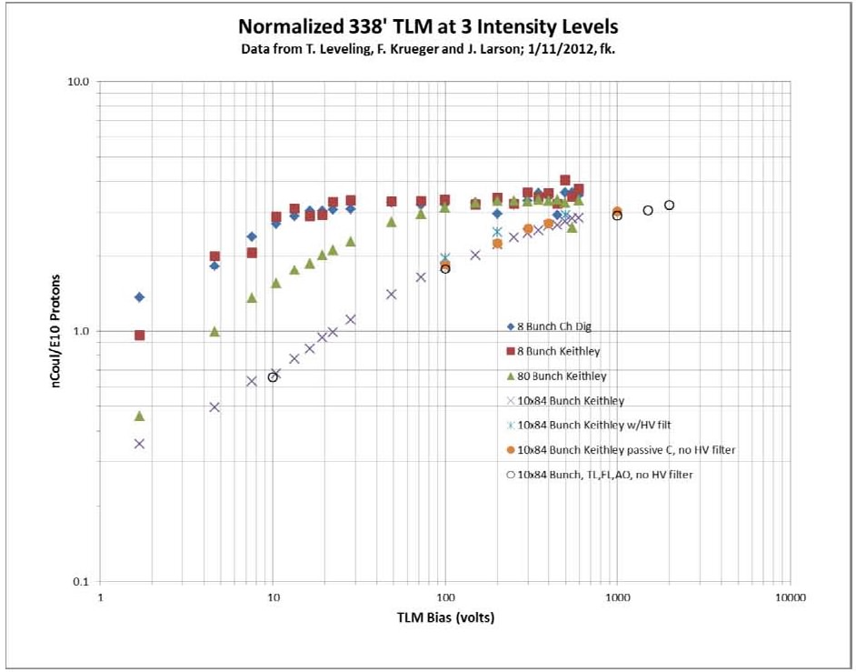

Slide 20
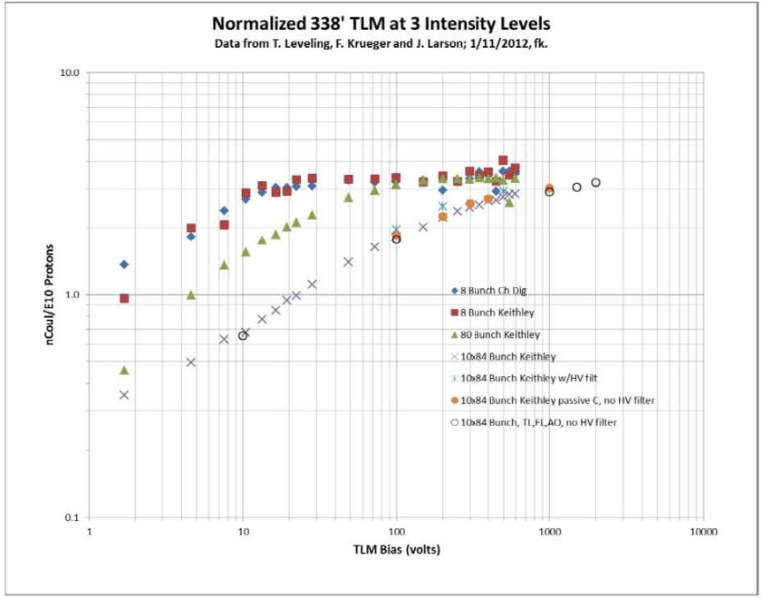
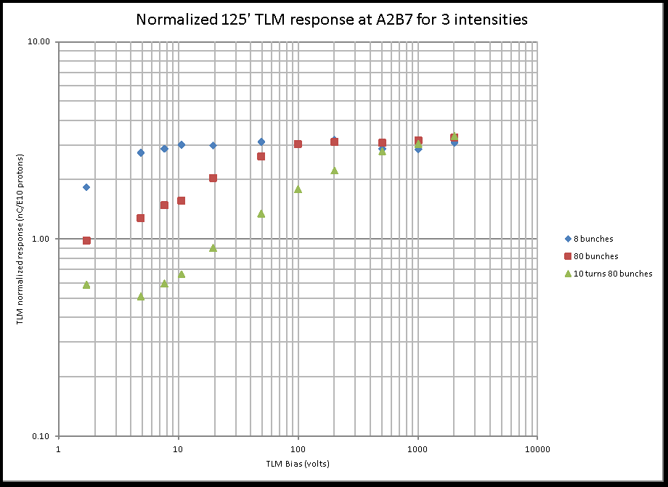
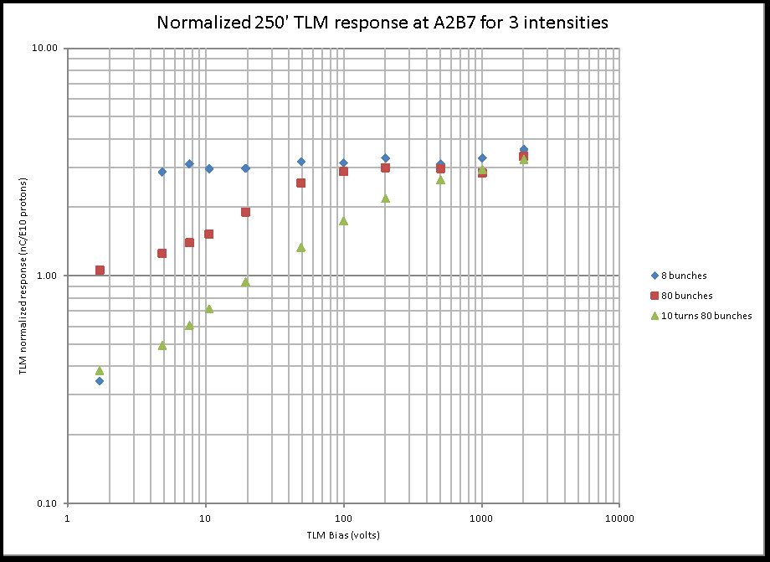
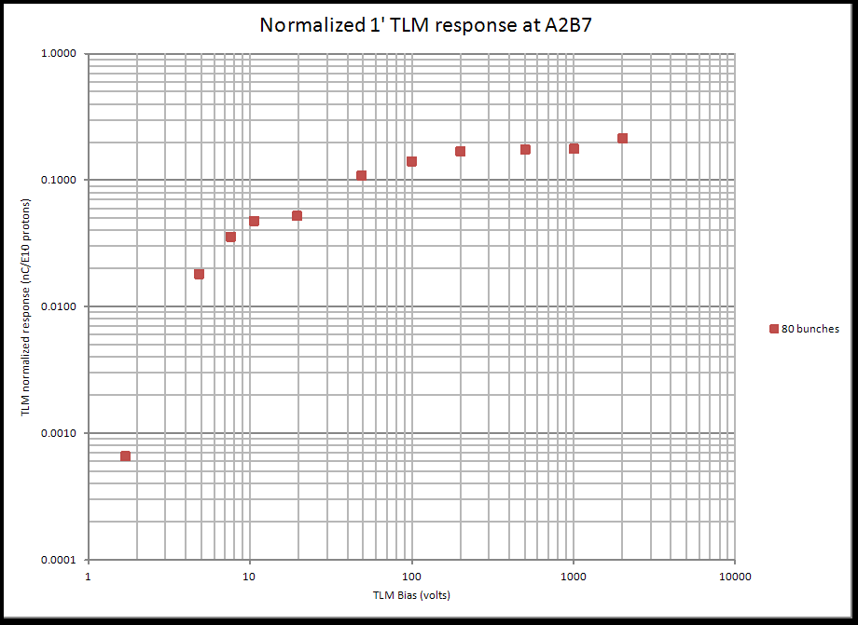
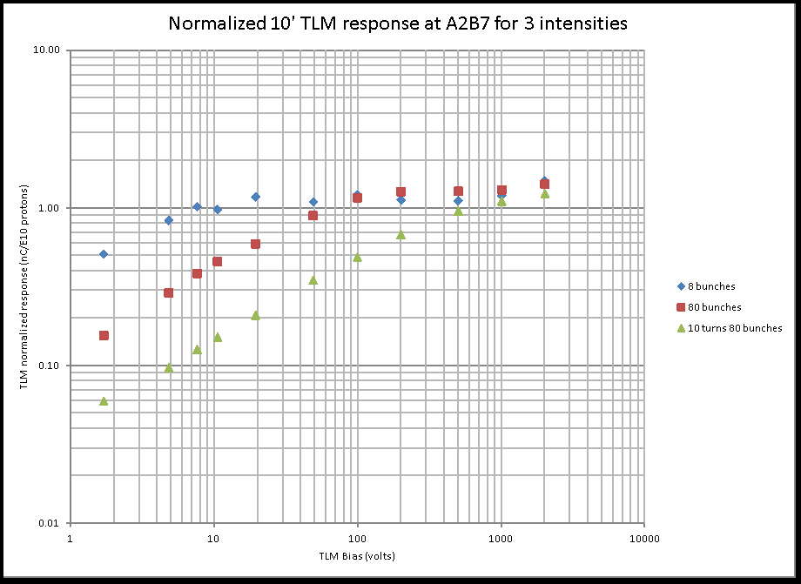

Slide 21
Requirements Documents
(See TLM web site)

Slide 22
Requirements-Desirable
The TLM system must be able to limit beam losses to the level of 1 watt/meter which has become the acceptable loss limit that still allows maintenance activities on tunnel components.
The TLM system must be made to connect directly to the existing Radiation Safety System, preferably into the existing Chipmunk or Scarecrow radiation interlock cards.
The TLM electrometers must provide a stable HV source for the TLM cable at nominally 0.5 kV. The stability of the supply should be <0.1%.
The TLM system must be fail safe:
If the readout electronics loses power, the Radiation Safety System(RSS) must be disabled.
If a TLM chamber is disconnected from its readout electronics, the RSS must be disabled.
The TLM must have a self-check heartbeat that matches the existing heartbeat from the Chipmunk or Scarecrow. A minimum signal needs to be monitored that will satisfy the readout card heartbeat requirement. The loss of such signal must cause the RSS to be disabled.
If the TLM High Voltage supply falls outside of the set range (adjustable as required), the RSS must be disabled.
The TLM source gas supply pressure must be monitored. If the gas source pressure drops below a nominal range, approximately 100 psig, the RSS must be disabled.
Gas flow is important to prevent the buildup of polyethylene out-gas poisons. The gas flow at the exit of the TLM, or a chain of TLMs, must be monitored. In the event gas flow is reduced below a predetermined range, the RSS must be disabled. Note: Very low flow is sufficient, e.g. 25 cc/min.
The TLM electrometer must be able to collect charge with a 100% duty factor, i.e., no dead time for integrator reset. Note: The existing Chipmunk and Scarecrow devices use a quantized charge removal system. This provides rate information proportional to the radiation field being measured.
A calibration schedule and procedure for the readout electronics must be developed.
The response of the TLMs must be characterized for different beam losses.
Requirements-Desirable
The gas species has a dramatic effect on TLM sensitivity. The gas thermal conductivity should be monitored to guard against an incorrect gas bottle being connected to the system. If thermal conductivity of the gas falls out of the normal range, the RSS should be disabled.

Slide 23
8 GeV TLM response constant |  | TLM baseline energy |  |  | Energy scalling factor |  |  | Baseline TLM distance to beam center
3.2 | nC/E10 | 8 | GeV |  |  | 0.8 |  | 5.5 | feet
Machine/Condition | Note | Beam power (KW) | Energy (GeV) | Protons per hour | Average intensity per second | Nominal Shielding feet | Magnet to ceiling distance | Shield Category or application basis | beam loss limit (p/s) | normal loss limit p/s | % of beam loss | nC/min (per meter in bold)
Mu2e Service Bldg. | 1 | 4 | 8 | 1.13E+16 | 3.13E+12 | 10 | 5.5 | skyshine | 3.3 watts | 2.58E+09 | 0.082% | 50
Mu2e Service Bldg. | 1 | 8 | 8 | 2.25E+16 | 6.25E+12 | 10 | 5.5 | skyshine | 3.3 watts | 2.58E+09 | 0.041% | 50
Mu2e Shielding Berm | 2 | 4 | 8 | 1.13E+16 | 3.13E+12 | 13 | 5.5 | 1A | 3.26E+10 | 1.63E+09 | 0.052% | 31
Mu2e Shielding Berm | 2 | 8 | 8 | 2.25E+16 | 6.25E+12 | 13 | 5.5 | 1A | 3.26E+10 | 1.63E+09 | 0.026% | 31
Booster May 2013 | 5 | 64 | 8 | 1.80E+17 | 5.00E+13 | 14 | 4 | 2A | 2.20E+11 | 1.10E+10 | 0.022% | 399
Booster 2016 | 5 | 80 | 8 | 2.25E+17 | 6.25E+13 | 14 | 4 | 2A | 2.20E+11 | 1.10E+10 | 0.018% | 399
Booster (any pwr) | 3 |  | 8 |  |  | 14 | 4 | 1 W/m | NA | 3.91E+11 |  | 14,175
Main Injector | 2 | 700 | 120 | 1.31E+17 | 3.65E+13 | 24 | 5 | 1A | 2.61E+13 | 1.31E+12 | 3.582% | 265,094
Main Injector | 2 | 2,300 | 120 | 4.31E+17 | 1.20E+14 | 24 | 5 | 1A | 2.61E+13 | 1.31E+12 | 1.090% | 265,094
Main Injector | 3 | 700 | 120 | 1.31E+17 | 3.65E+13 | 24 | 5 | 1 W/m | NA | 1.82E+11 | 0.499% | 36,960
Main Injector | 3 | 2,300 | 120 | 4.31E+17 | 1.20E+14 | 24 | 5 | 1 W/m | NA | 1.82E+11 | 0.152% | 36,960
Nova | 2 | 700 | 120 | 1.31E+17 | 3.65E+13 | 26 | 3 | 1A | 4.87E+13 | 2.44E+12 | 6.675% | 1,372,243
LBNE | 2 | 2,300 | 120 | 4.31E+17 | 1.20E+14 | 26 | 3 | 1A | 4.87E+13 | 2.44E+12 | 2.030% | 1,372,243
Nova | 4 | 700 | 120 | 1.31E+17 | 3.65E+13 | 26 | 3 | 10 ppm | NA | 3.65E+08 | 0.001% | 206
LBNE | 4 | 2,300 | 120 | 4.31E+17 | 1.20E+14 | 26 | 3 | 1 W/m | NA | 5.21E+07 | 0.000% | 29
Notes: | 1 | Distributed or concentrated loss limits public exposure to 1 mrem per year
 | 2 | Single point loss limits berm surface normal condition dose rate to 0.05 mrem/hr
 | 3 | Total charge limit in tunnel beam loss to 1 W/m - distributed among some number of TLMs
 | 4 | Limit total beam loss to 1 part in 1E5
 | 5 | Single point loss limits berm surface normal condition dose rate to 5 mrem/hr
Not recommended
The scaling of TLM response for energy needs to be
Checked in a MARS calculation!!!!

Slide 24
Dynamic Range
At 3.2 nC/E10 protons
Full beam power loss of a single 5E13 pulse at 120 GeV would produce 118 uC
No intention to measure/detect for this level
For 1 W/m loss around the MI, a total of 0.6 nC/MI pulse is produced
Divided among 12 TLMs a total of 0.05 nC/pulse
A 3.5E12 pulse at 8 GeV would produce about 1 uC
Arbitrarily, a 1-2 uC/pulse upper limit is probably sufficient
All anticipated trip levels are well below this per pulse limit

Slide 25
Digitizer circuit
Suppose 5 uC/minute is a reasonable upper control limit
Rad card input upper limit
10 kHz (?)
Then digitizer charge per output pulse

Slide 26
Chipmunk digitizer
For comparison
0.5 pC/pulse, 2.5 pC/pulse or 5 pC/pulse (selectable)

Slide 27
Low trip level
Lowest trip level from table is 31 nC/min
The rad card trip level for mu2e berm arcs would be

Slide 28
TLM needs a heartbeat
Add resistor across TLM to force current
For a 60 cpm background
Assume 500 volt bias
8.33 pC/pulse or 8.33 pA
R= 60 teraohms

Slide 29
TLM electrometer Form Factor

Slide 30
Panel mounted for installation in relay rack
SHV connector output for TLM bias
BNC connector signal input from TLM
Output signals connect to RSS through Burndy connector
HV OK?
DC voltage
Digitizer output as TTL
Other?
120 volt power cord
Status lights
HV
Heartbeat reflection

Slide 31
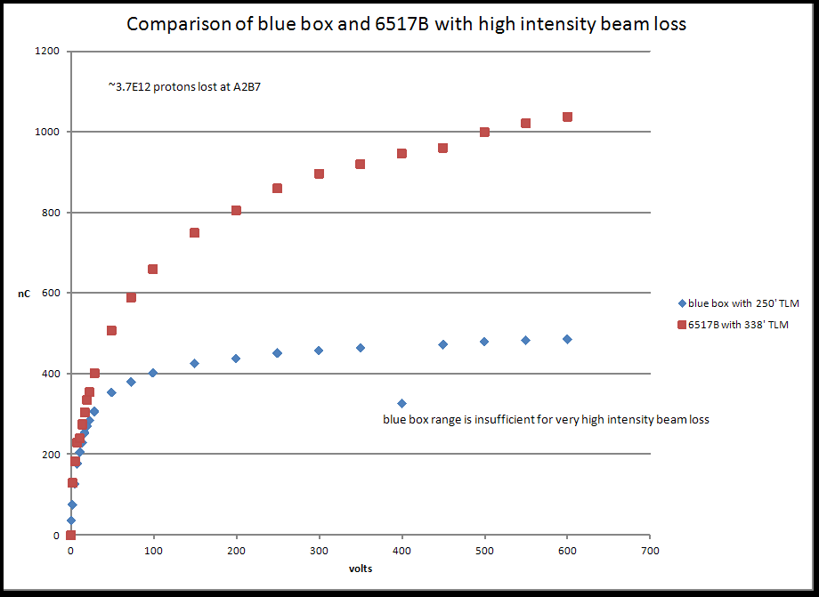

Slide 32
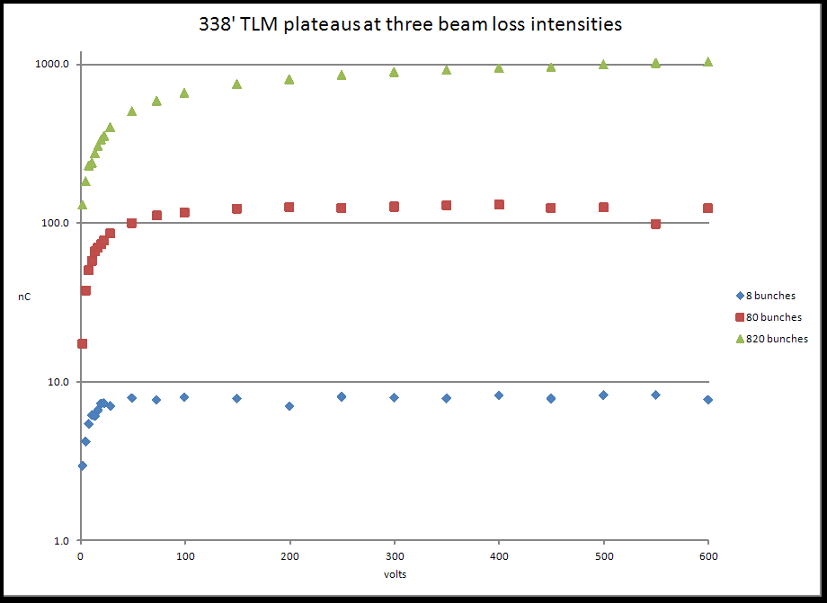

Slide 33
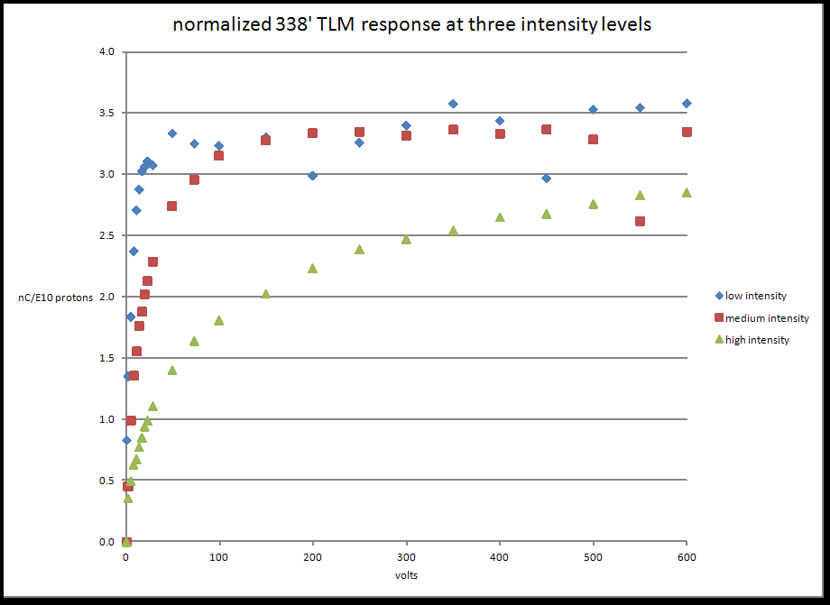

Slide 34
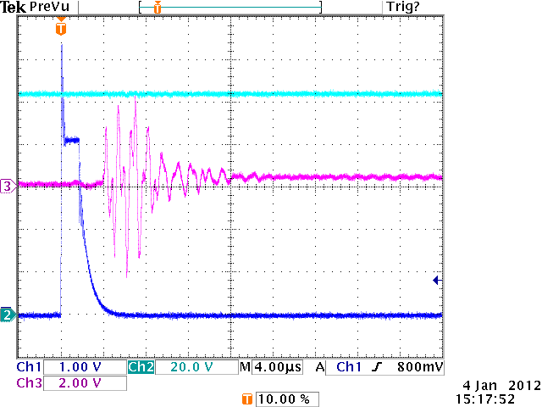
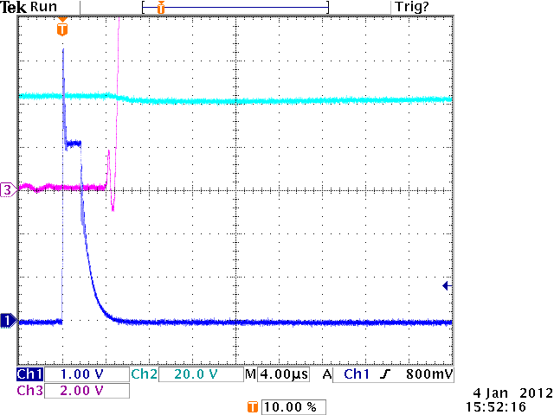
3.1E10 protons
3.35E12 protons
Scope terminated into 1 Mohm

Slide 35
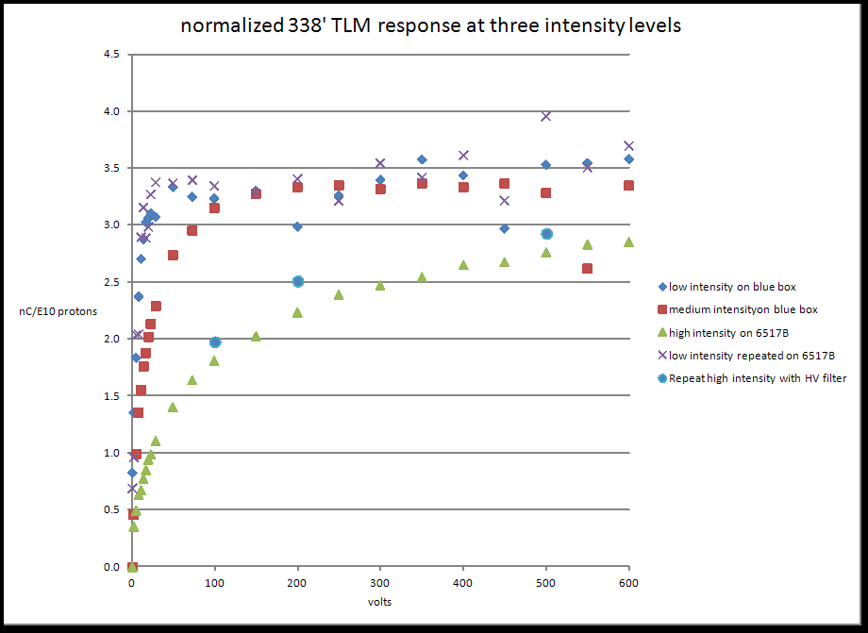
Added in line capacitance to HV

Slide 36
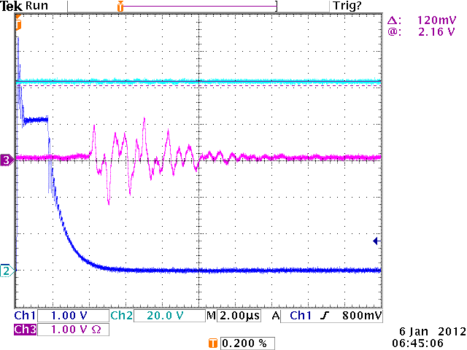
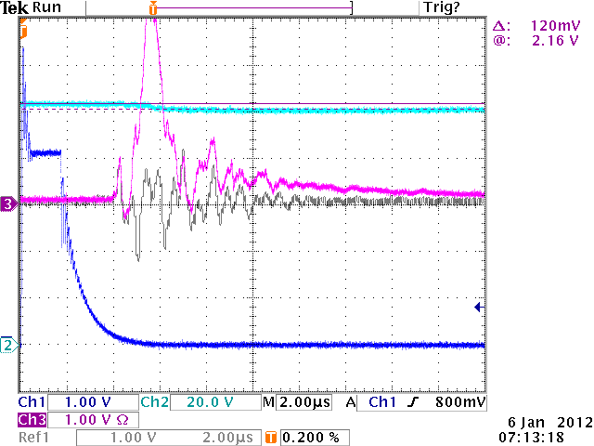
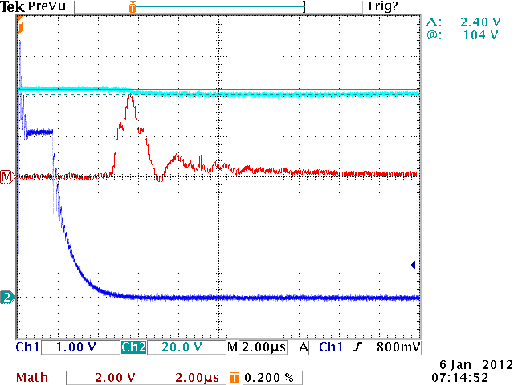
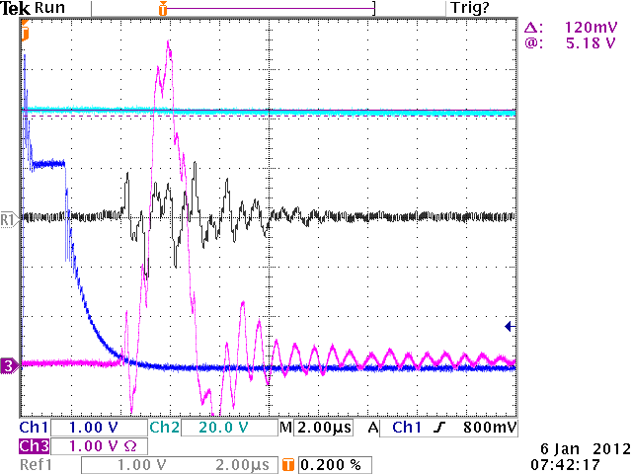
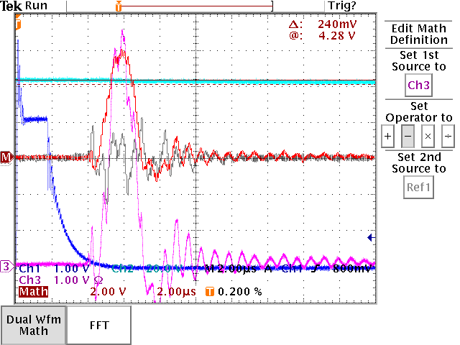
without inline HV capacitance
with inline HV capacitance

Slide 37
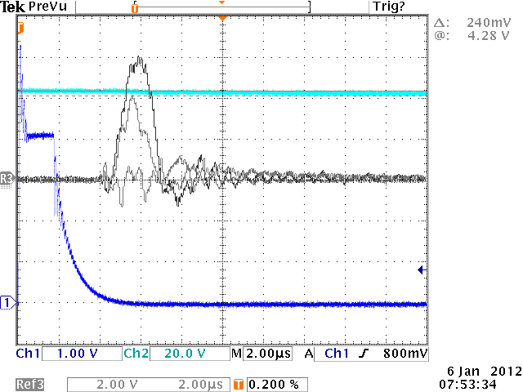
3
2
1
Three traces: 1- background, 2 – without HV cap, 3 – with HV cap

Slide 38
Compared Scope measurement with 6517B for similar beam loss
With TLM HV at 100 volts
Scope with no HV filter – 155 nC
Scope with HV filter – 145 nC
With 6517B – 660 nC
Scope technique didn’t work

Slide 39
Continued high intensity plateau measurements
Used capacitor voltage divider and 6517B in voltage mode
Results are similar to direct charge measurements with 6517B
Did a few additional points at higher voltages, up to 2000 volts

Slide 41
TLM use at the intensity Frontier
Clearly, beam intensity could be high enough to saturate TLMs
All measurements to date at 8 GeV
Response of TLM at 120 GeV expected to be:
(E₁₂₀/E₈)^{0.8} X 3.2nC/E10 protons = 28nC/E10 protons

Slide 42
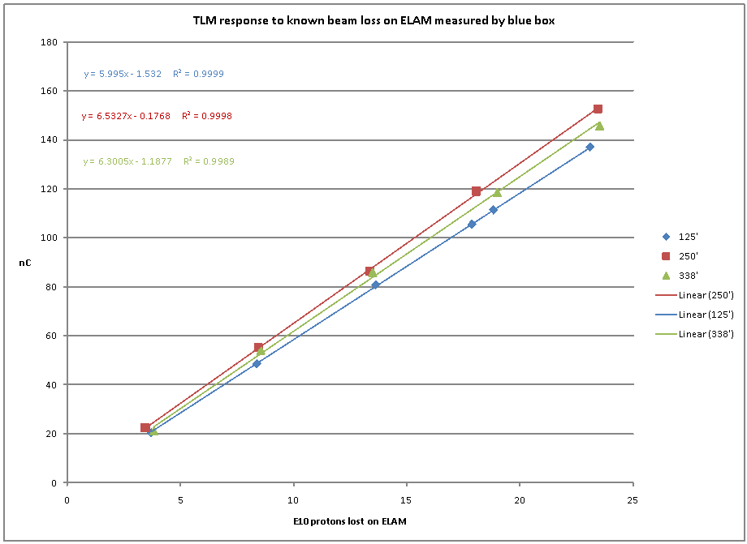
Saw this in September while
comparing blue box response to BLM chassis

Slide 43
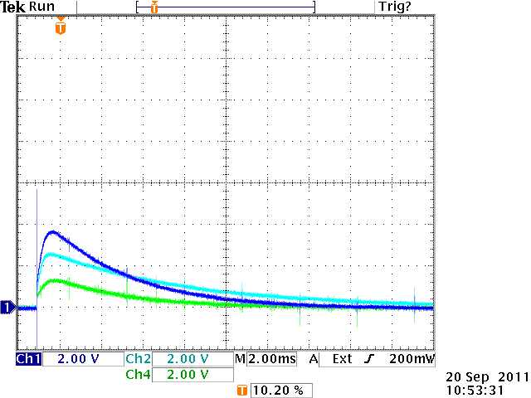
Ch1 – 125’
Ch2 – 250’
Ch4 – 338’

Slide 44
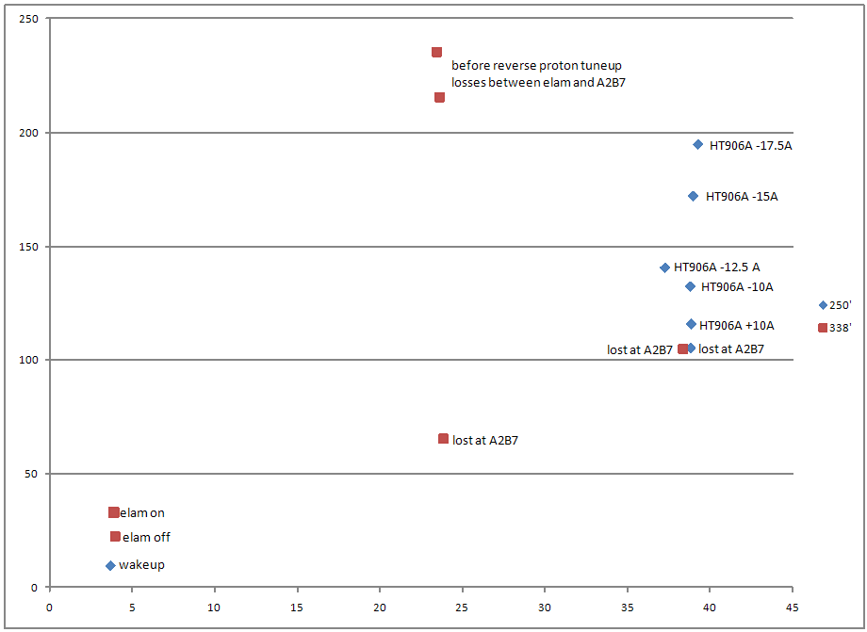
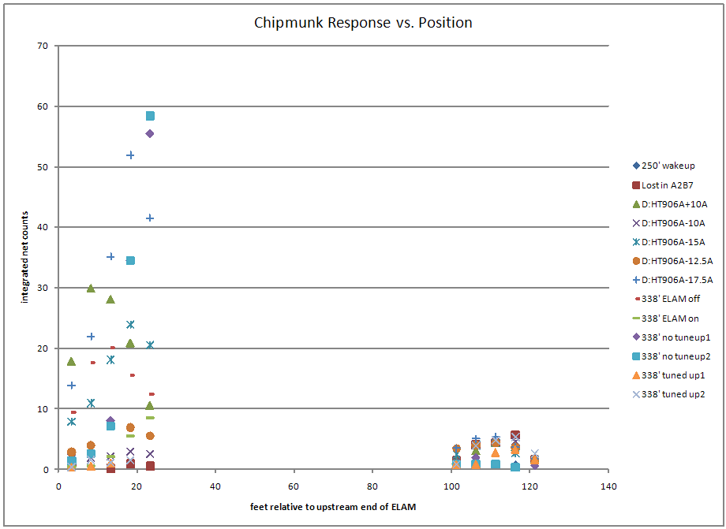
TLM response varies
with different loss mechanisms
Use the most conservative condition
to establish safety system trip

Slide 46
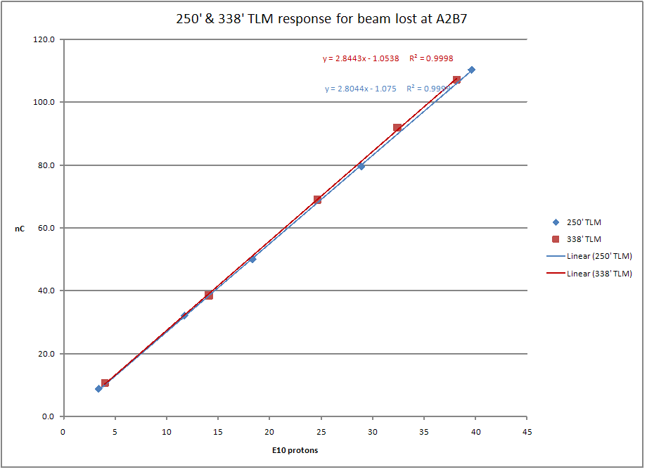

Slide 47
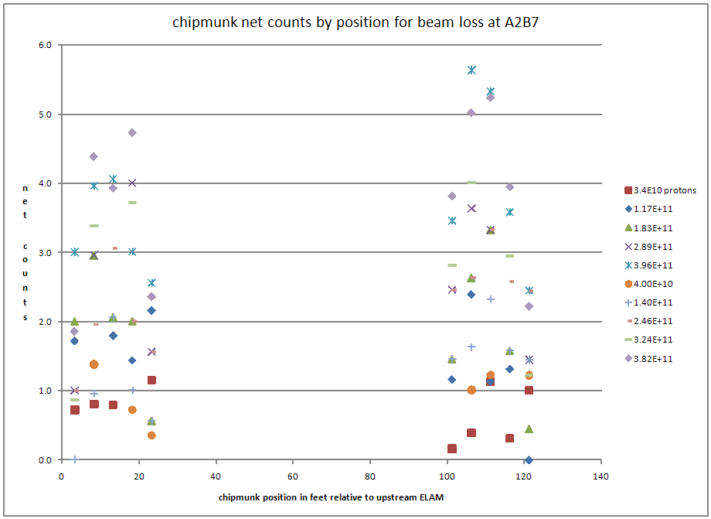

Slide 48
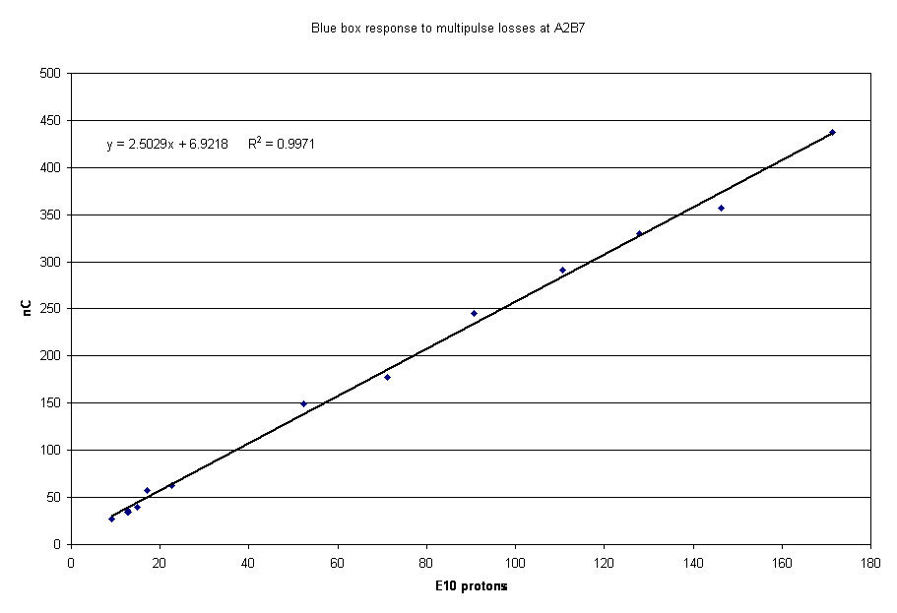

Slide 49
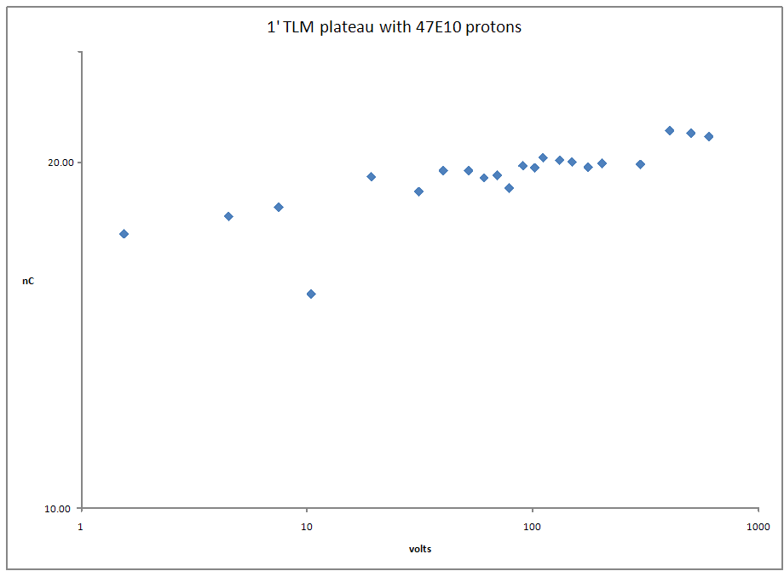

Slide 50
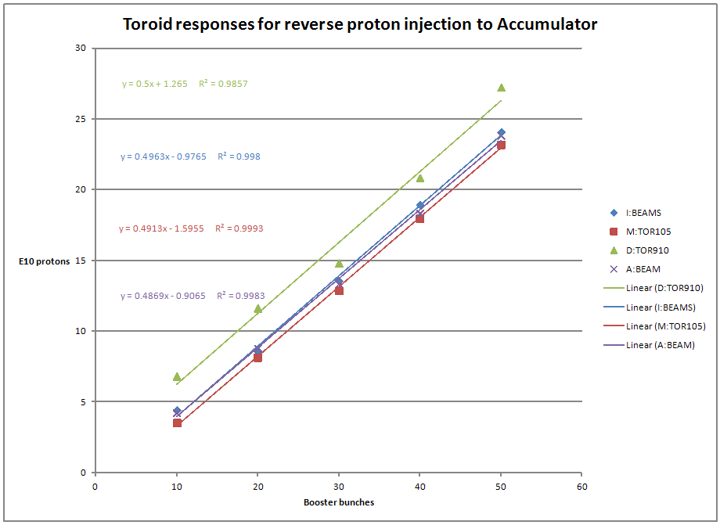

Slide 51
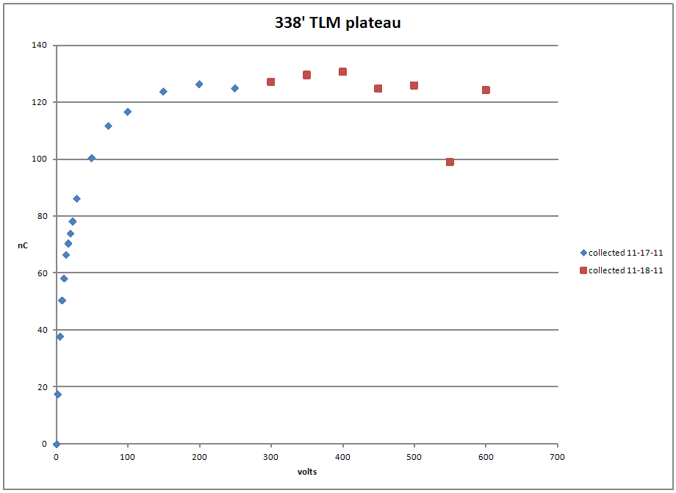
4E11 protons into A2B7

Slide 52
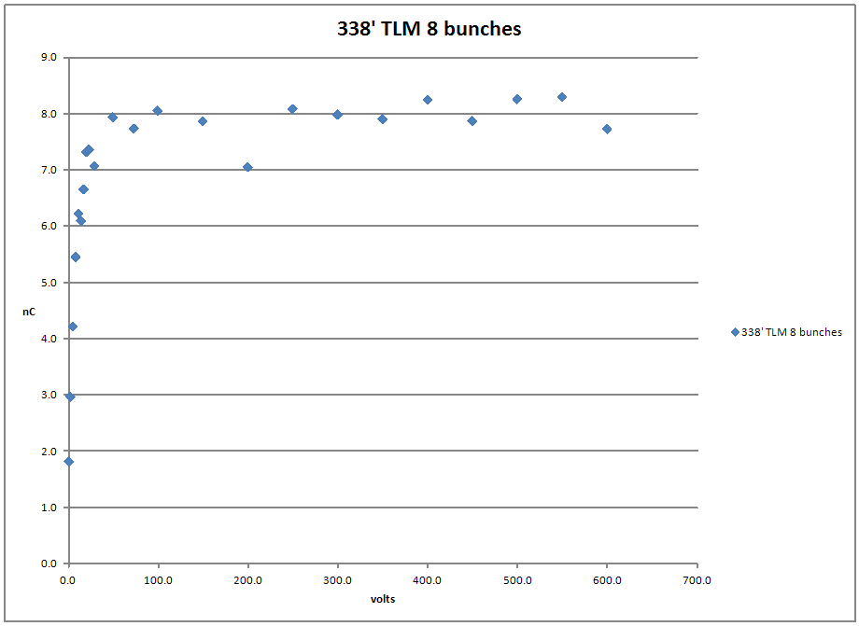
8E10 protons into A2B7

Slide 53
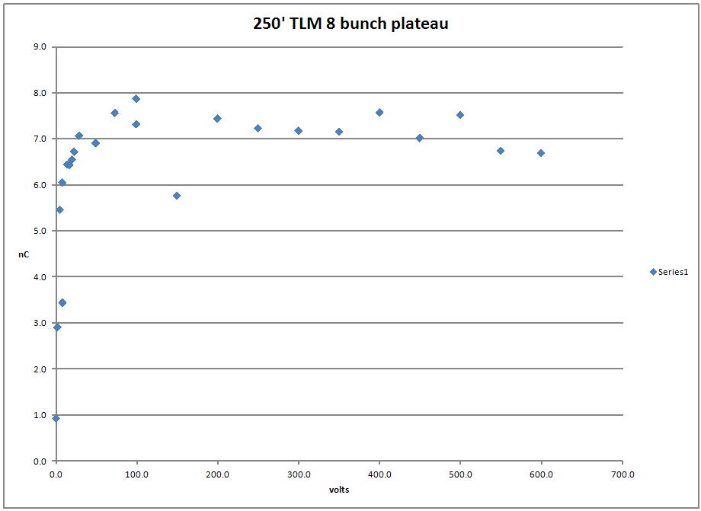

Slide 54
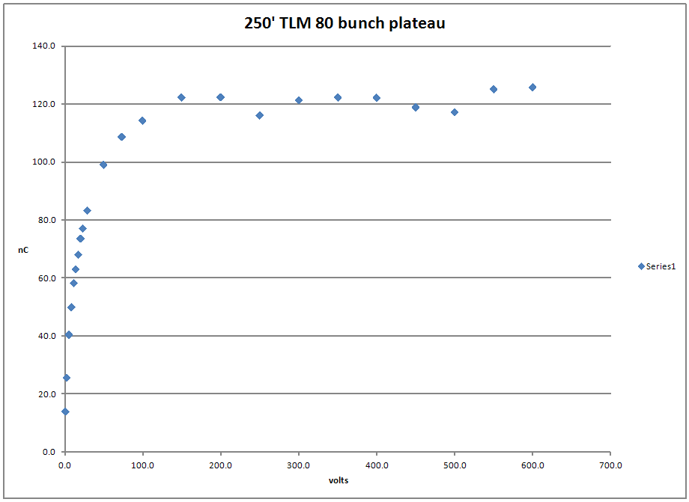

Slide 55
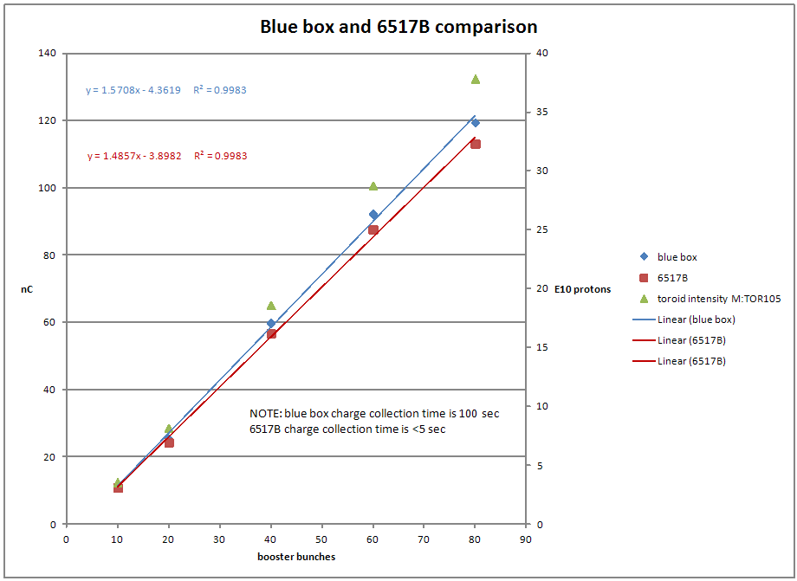

Slide 56
Next steps
Finish charge collection time measurement
Probably requires max intensity to get a signal
Do high intensity plateaus for 250’ and 338’ TLMs
Use 6517B for one and blue box for the other
Then switch
Look for roll off in blue box response

Slide 57
TLM electronics development resources
Management
EE?
ES&H?
M&S
Probably need a budget for this
First, need an estimate?
Funded by users?
ES&H
Mu2e
Pixie
Others
Resources
ES&H files
Labor
Marv
Others?

Slide 58
Since the last meeting
Current BLM chassis contains:
6 decade log rate cards
0.014 RADS
0.14 RADS
1.4 RADS
14 RADS

Slide 59
Scope pictures
125 foot response
250 response
50 Booster bunches
Partial scraping loss on elam

Slide 60
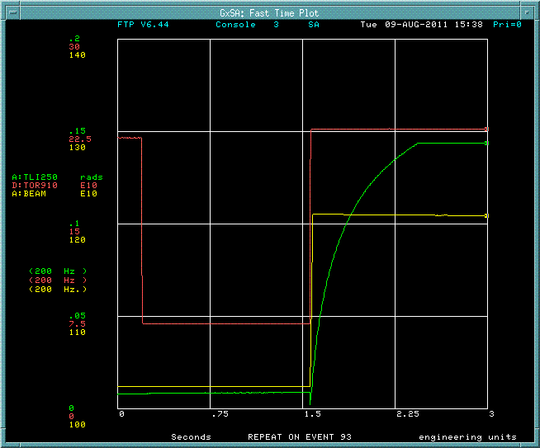
0.14 RAD cards saturate
Partial scraping loss on ELAM
50 Booster bunches
D:HT906A + 10A

Slide 61
Repeated 2000 Pbar SA measurement
Counts per mA lost
Expected these curves to be consistent
Demonstrates that scraping loss is unreliable technique to establish response

Slide 62
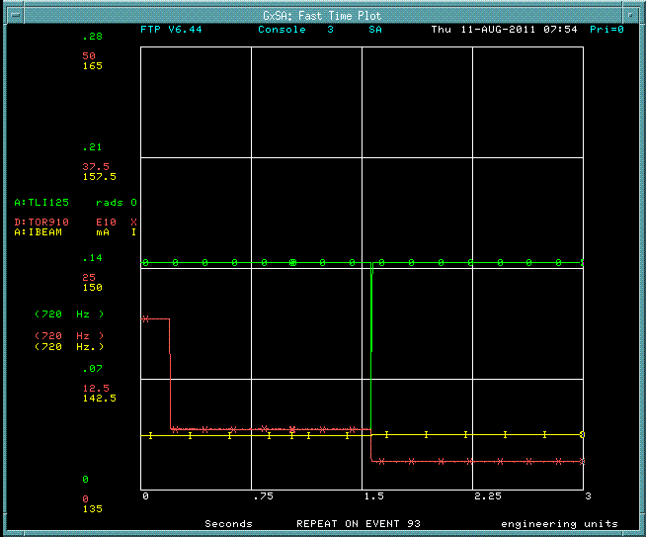
Single resets do not clear BLM cards in all cases

Slide 63
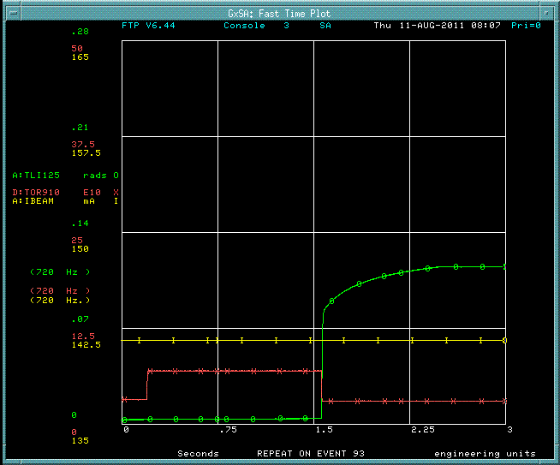
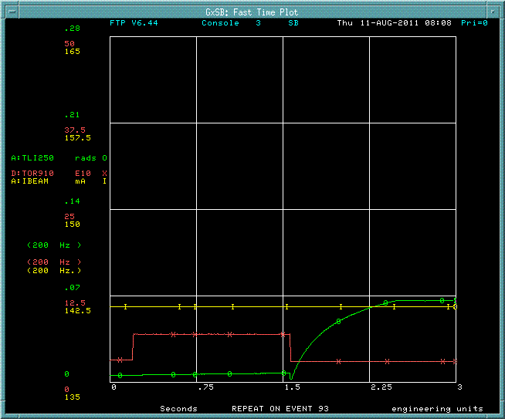
Clear on 00 event and 93 event
Used reset at beginning of transfer timeline to clear integrator

Slide 64
TLMs samples on 93 reverse proton tuneup event
Transfers over 24 h period
TLM response coincident with chipmunk response outside of shielding

Slide 65
Small negative currents occur
e.g. when
beam goes away
Chipmunks have Cs-137 source to drive current

Slide 66
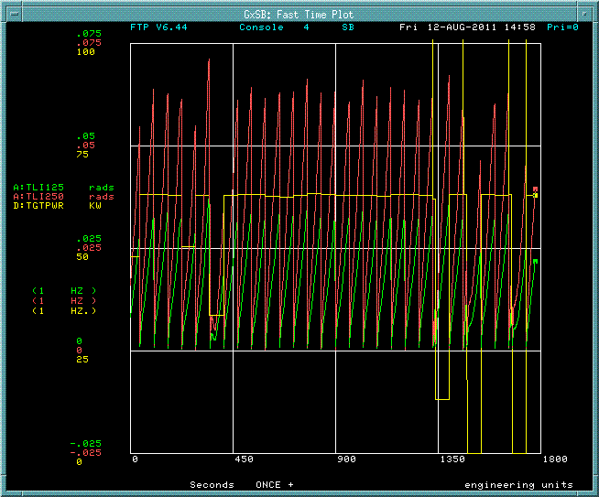
Some minutes of operation

Slide 67
Script has been written to ramp elam simplifies beam loss studies
Script by DVM

Slide 68
TLM response correlated with beam power on target by timeline variation

Slide 69
TLM response correlated with stacktail performance
TLM response to very subtle effects
Suggests good sensitvity

Slide 70
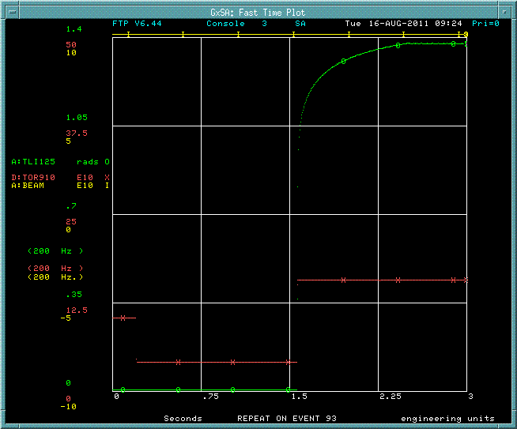
A series of measurements have been variable beam loss
35 Booster buckets - 15.7E10 protons
Others in 5 bucket increments from 5 to 50

Slide 71
Recorded response of 5 chipmunks

Slide 72
Chipmunk response is linear with number of protons lost
An expected
result

Slide 73
TLMs also have linear response!
A required result
NOTE!
125 foot response exceeds 250 foot response
250’ TLM response = 70%*125’response

Slide 74
TLM response as a function of length
Need another TLM installed to determine this!

Slide 75
During stacking operations
250’ cable response exceeds 125’ response during normal stacking operations
Could be losses in the second half of 250’ TLM not seen by 125’ TLM
A reverse proton cycle mixed in with stacking cycles

Slide 76
Tried reversing HV and signal roles of the TLM cable
Huge apparent increase in sensitivity
Perhaps should be repeated – ensure conductors are grounded before turning on HV

Slide 77
Blue box is in service connected to 125’ TLM

Slide 78
Blue box is in service connected to 125’ TLM

Slide 79
Blue box is in service connected to 125’ TLM
5 pC/count
Follows BLM card response on 250’ TLM

Slide 80
Next steps (1 of 3)
Install VME scalar for higher counting rate from blue box (1 kHz)
MUX good for 70 Hz
VME scalar good for 15 kHz
Repeat series of measurements with blue box and BLM chassis two ways
Blue box/125’ & BLM chassis/250’
Blue box/250’ & BLM chassis/125’
Determine dynamic range requirement for digitizer circuit for TLM application

Slide 81
Next steps (2 of 3)
Install third TLM of different length 103 m (338’)
Determine TLM response as function of length
Can’t do this with just 2 cables
Repeat measurements (5 Booster bunch increments)
Determine how AD instrumentation can make additional blue boxes
In collaboration with ES&H Section
Would help to speed up development of this resource

Slide 82
Next steps (3 of 3)
Distributed loss study
e.g., Scrape at ELAM with Accumulator bend bus off (October 2011?)
Determine blue box trip levels for 14 TLM cables required for mu2e
Needed to finalize radiation safety plan for mu2e

